Slide 1

New York City
Demographics, Income, & Rent
Analyzing Trends from 2010-2020
Project 1 : Group 6
Christine
Natalia
Rafael
Andrea
Ashley

Slide 2

How Have Demographics, Income, and Rental Prices Changed from 2010-2020?
In this analysis we collected data for each borough of New York City and examined trends from 2010-2020 with 5 different variables:
Rental Pricing
Income
Gender
Age
Ethnicity

Slide 3

Rental Prices
The following charts and tables will break down the rent prices in one of the most expensive cities in the US. Broken down by borough we will compare the price in rent over a 10 year range from 2010-2020 with data pulled from Street Easy. The ranking of boroughs by rent prices has remained consistent over the span of 10 years with the exception of Staten Island falling behind the Bronx in the year 2020.

Slide 4
Rental Cost Questions:
Which is the most expensive borough to rent from in NYC?
Is the rate of increase similar across boroughs in the 10 year time frame?
What factors may have contributed to rise in rent?
Is there a correlation between the change in rent prices and income level?
How has the change in rent prices affected the demographics of NYC?

Slide 5
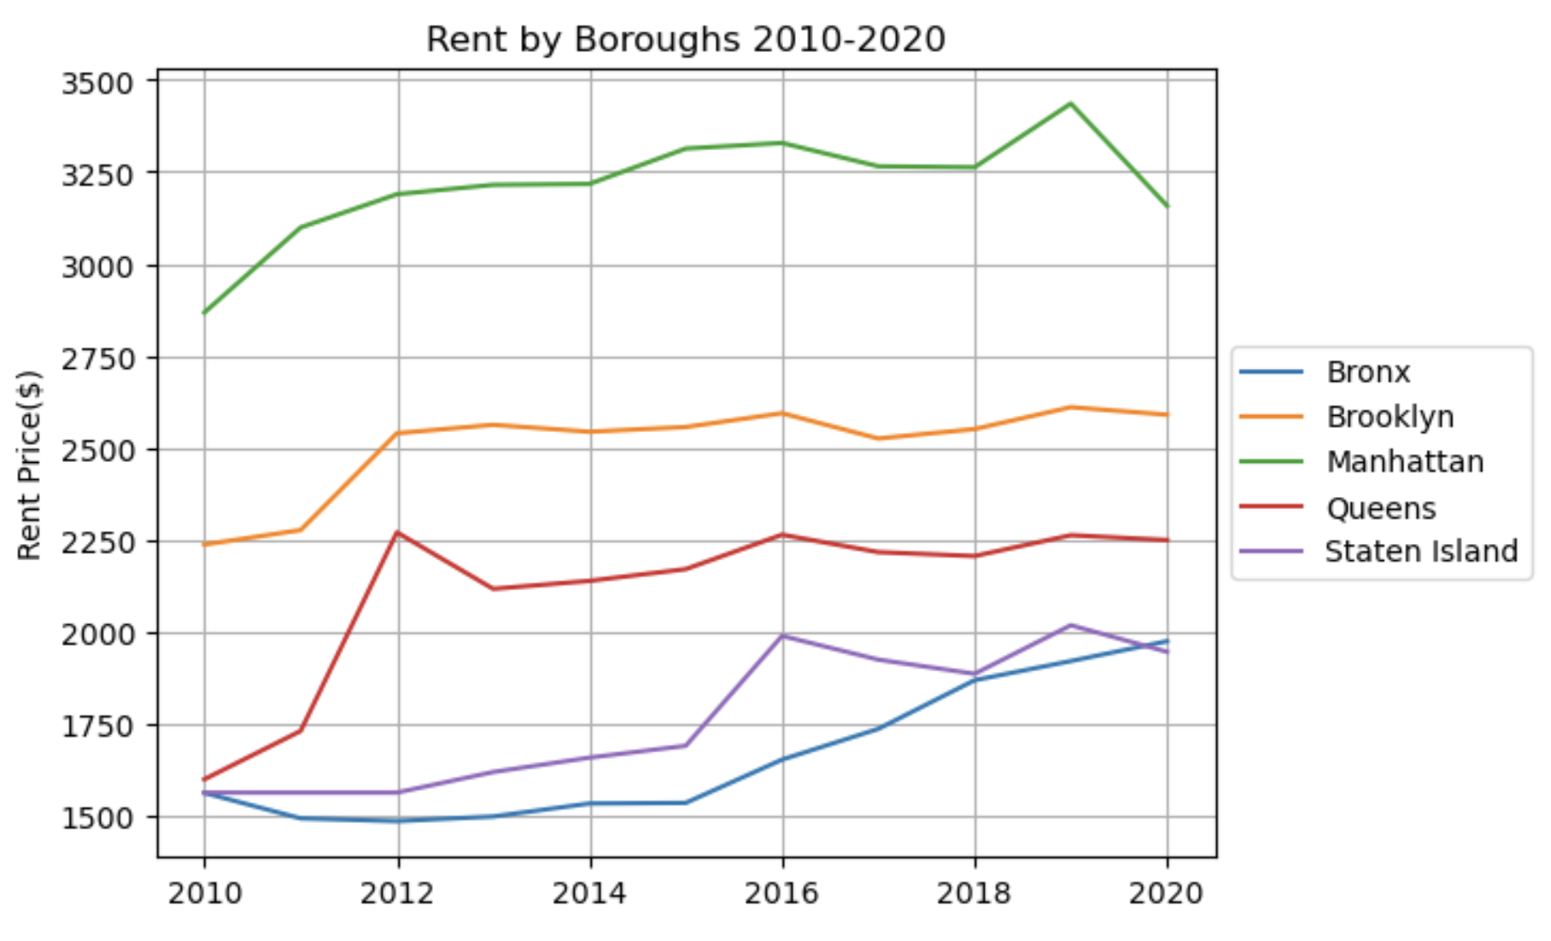
Annual Median Rental Prices

Slide 6
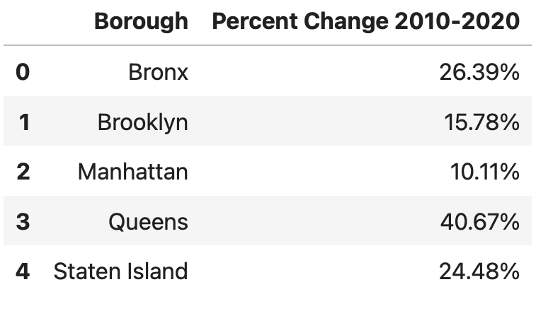
Percent Changes

Slide 7
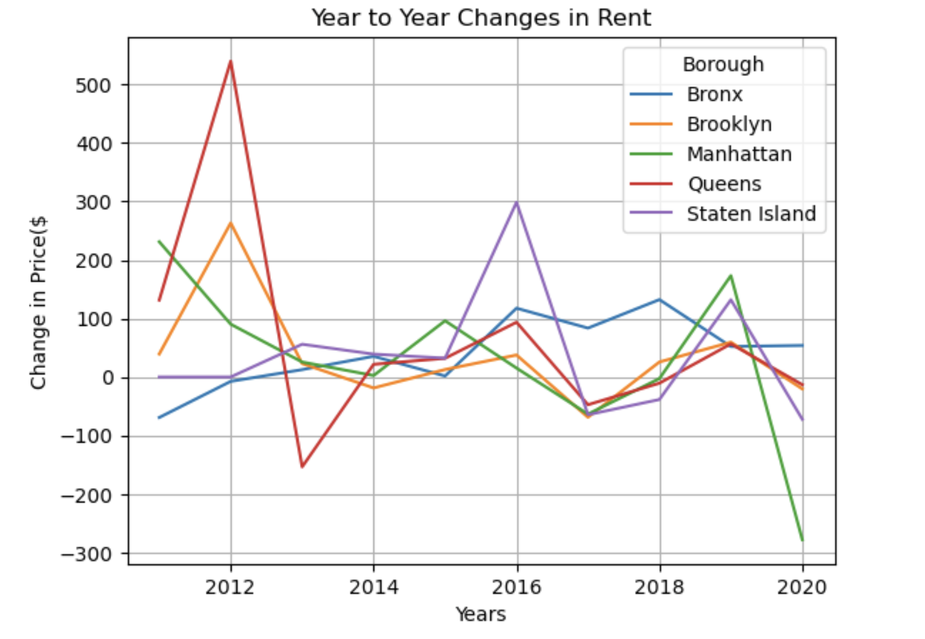
Annual Changes in Rent

Slide 8
Income Questions:
How does the median income levels of each borough progress over the course of 2010-2020?
How does the median income vary across the different NYC boroughs & how does that compare to the national median income during 2010-2020?
How does the cost of housing in each borough compare to its median income level?

Slide 9
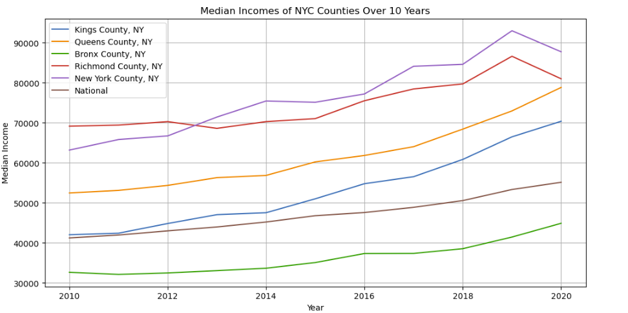
Annual Median Income

Slide 10
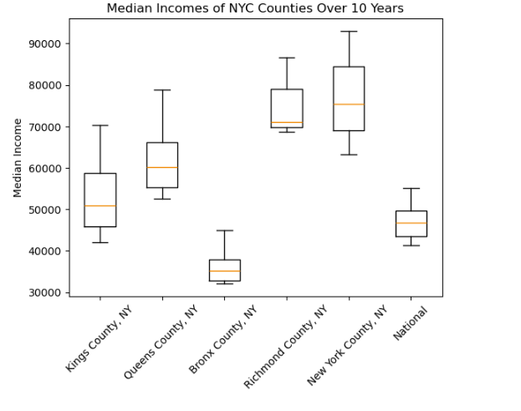
Annual Median Income

Slide 11
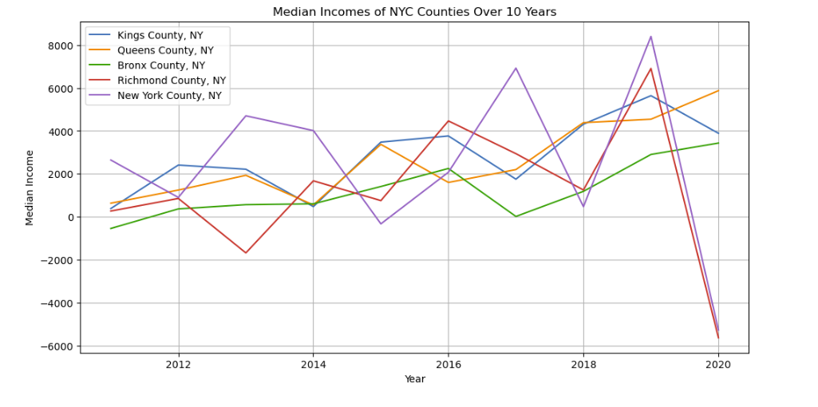
Year to Year Changes in Median Income

Slide 12
Income Answers:
How does the median income levels of each borough progress over the course of 2010-2020?
Manhattan and Staten Island had the highest median incomes over the course of 2010-2020. The Bronx had the lowest median incomes. All of the boroughs showed steady growth over the decade, except Manhattan and Staten Island both declined between 2019-2020. The national average income was lower than all of the boroughs except for the Bronx. However, the Bronx and the National medians had a very similar growth pattern. Overall, there seems to be a positive correlation between median income and years in this decade- aside from the Manhattan and Staten Island drop in 2019. The change in income is also relatively stable keeping within losing $2,000 and gaining $2000. Manhattan has three spikes in income change outside of this range- which we can see in 2013, 2015, and 2019. Manhattan and Staten Island also have a drastic decrease in median income in 2020.
How does the median income vary across the different NYC boroughs & how does that compare to the national median income during 2010-2020?
Most of the boroughs - with the exception of Staten Island have median that are close to the center of the interquartile range. Staten Island falls on the lower end. Manhattan and Brooklyn have the largest variability in income, while Bronx has the lowest variability. Bronx is also the only borough that falls below the national average. The Bronx and the national average hold similar variability. However, the box for the Bronx falls close to the lower income range. Brooklyn, Queens, and Manhattan appear to have the biggest range of income. Manhattan is most centrally located, indicating that both the upper and lower outliers extend equally as far. The remainder of the boroughs and the national show that they have a larger range of outliers that lie above the average variability.
How does the cost of housing in each borough compare to its income level?
In all cases we see a positive correlation between income and rental pricing. Manhattan, Queens, and Brooklyn show the income growing at a faster pace than the rental pricing. The Bronx and Staten Island see these two variables growing at a similar pace.

Slide 13
Income
If median income changes over the course of a decade are relatively close across multiple locations, it suggests a similar pattern of income growth or stability among the boroughs and across all of NYC. Despite there being differences in income levels in each borough- we are able to see a relatively similar pattern of growth over 2010-2020. This decade is interesting to look at, since the country was still recovering from the 2008 recession- the positive correlation of growing income by year is a testament to that.
Income levels can help provide insight into economic trends- this is not just limited to dollar amounts. It may also begin a conversation about other economic trends. Some of which may include: Industry trends, policy impact, and population dynamics. More businesses opening in a particular borough would lead to more job and in turn additional income- especially if the businesses are successful over that time period. A great example of policy impact would be raising minimum wage- this would directly affect income. Population dynamics is reflected in income in the possibility of people leaving Manhattan to find housing. This would be an influx in income. Brooklyn may provide a good example of these factors in 2012. We see both a jump in income and rental prices. It also happens to be when Barclay’s Center was constructed. This provided an influx of revenue, jobs, and more housing appeal. If analyzed, these factors would help build a more comprehensive study on these changes.
These trends are also an insight into the climate of the economy at the time. At the beginning of the decade the US economy was still recovering from a hard-hitting recession (as mentioned above).Inflation and CPI had a low point in 2015 and again in 2020 (bls.gov). Between 2010-2019 employment rate in NYC saw a steady increase, while available housing remained relatively stagnant (comptroller.nyc.gov). One limitation of this data set is using a limited range of years. Expanding this time frame could give a more comprehensive analysis with a larger dataset.
**CSV Data was obtained from US Census Data & The Federal Reserve of St Louis

Slide 14
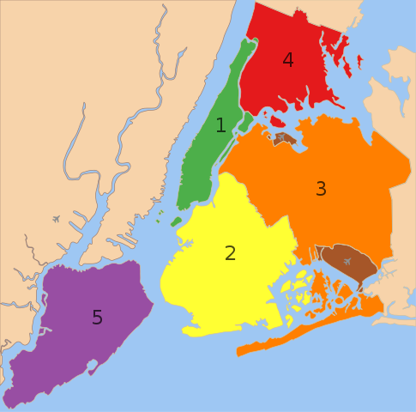
Income and Rental Pricing Linear Regression

Slide 15
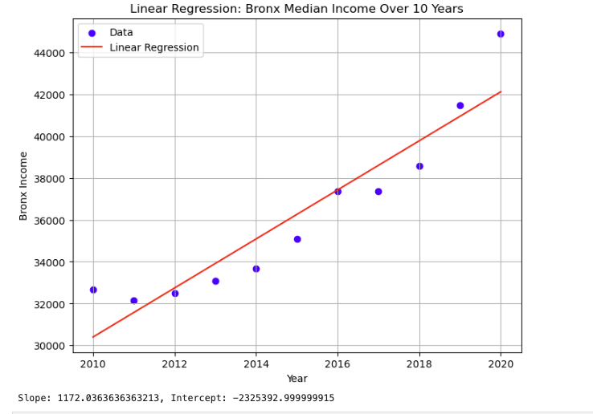
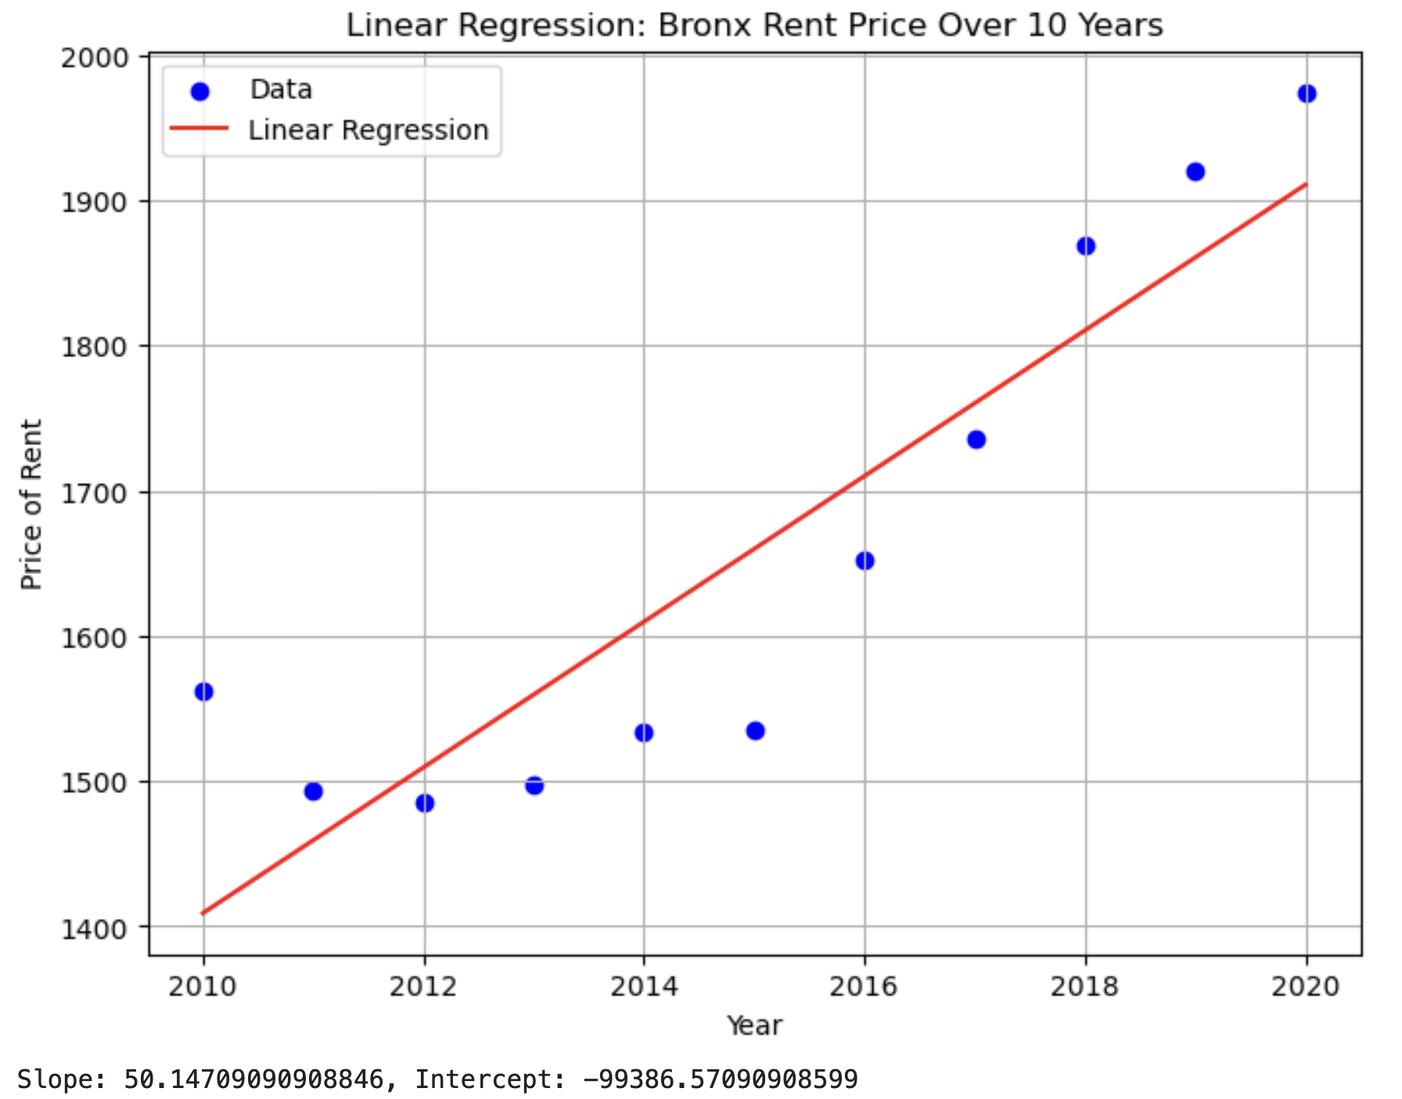
Bronx

Slide 16
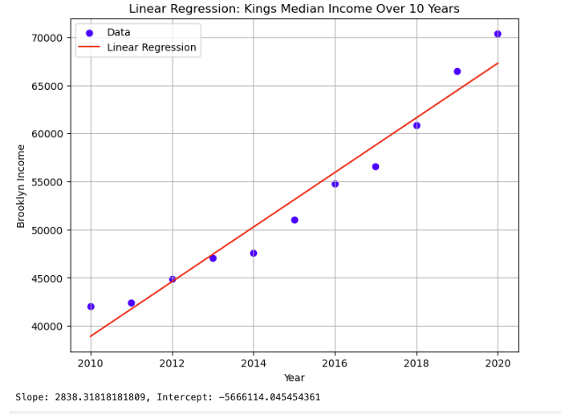
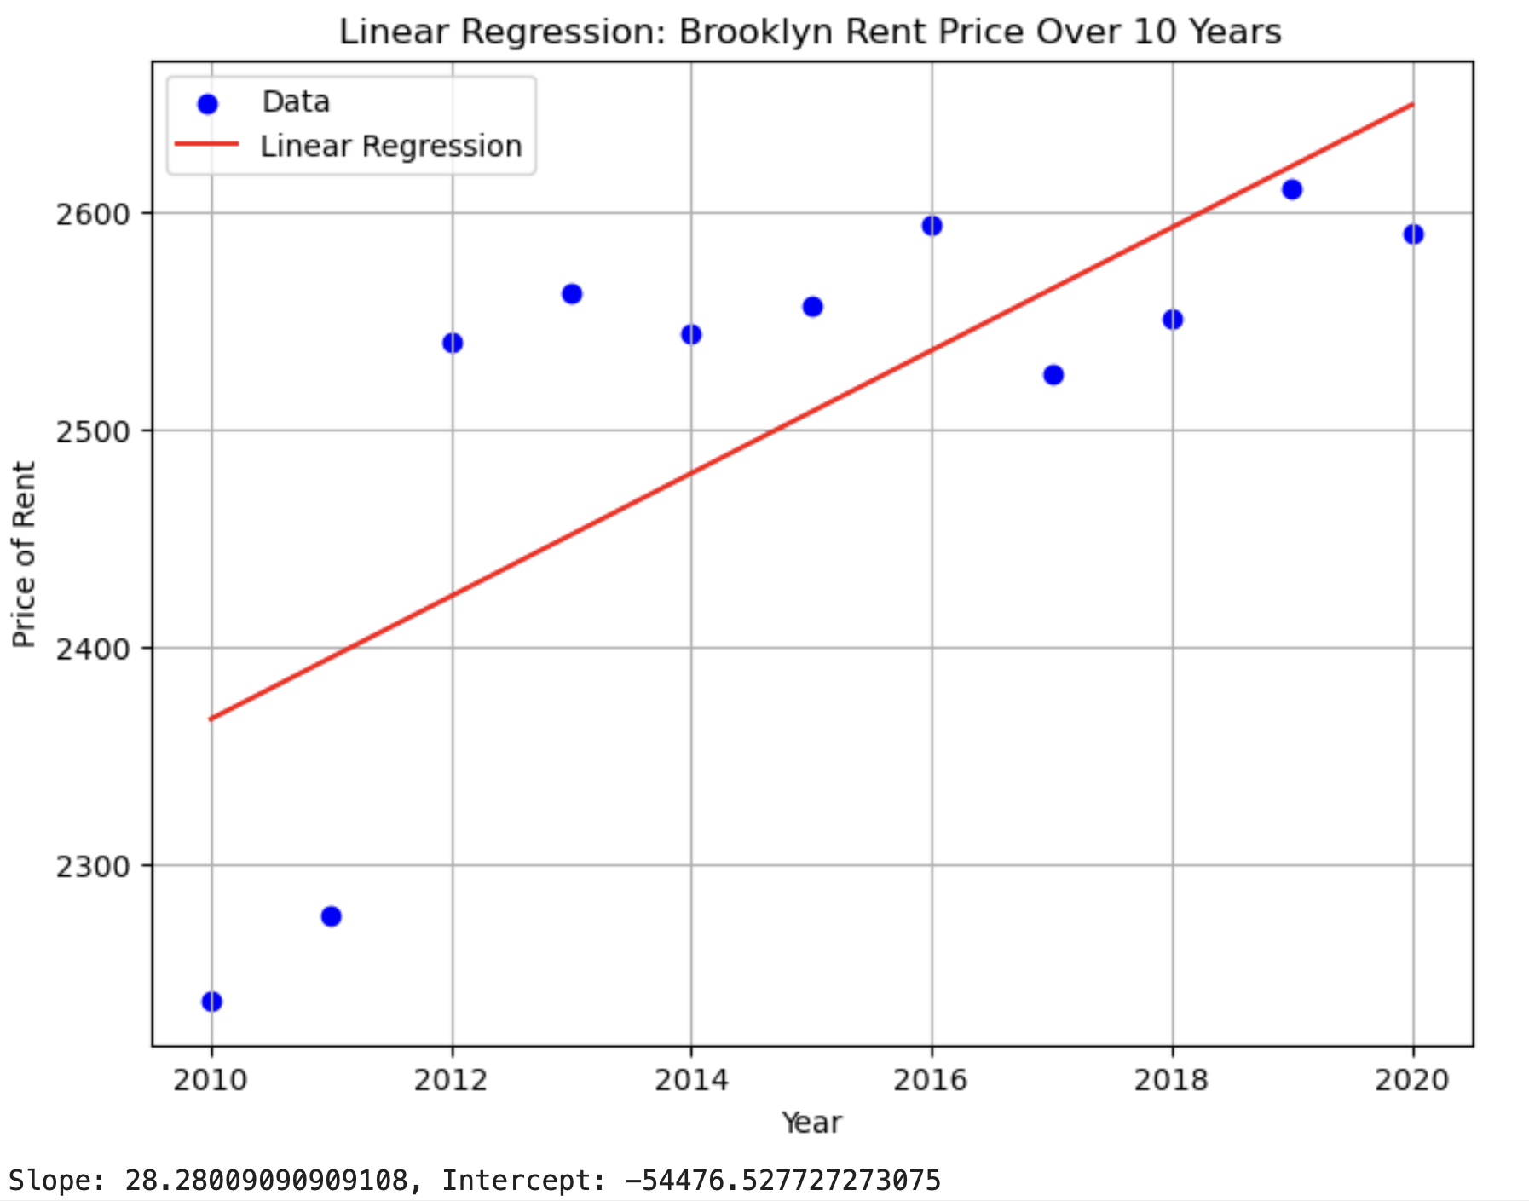
Brooklyn

Slide 17
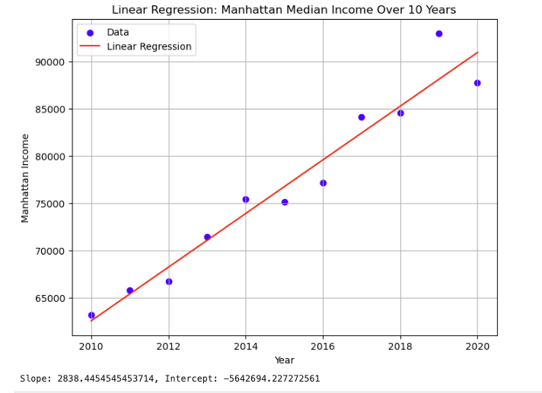
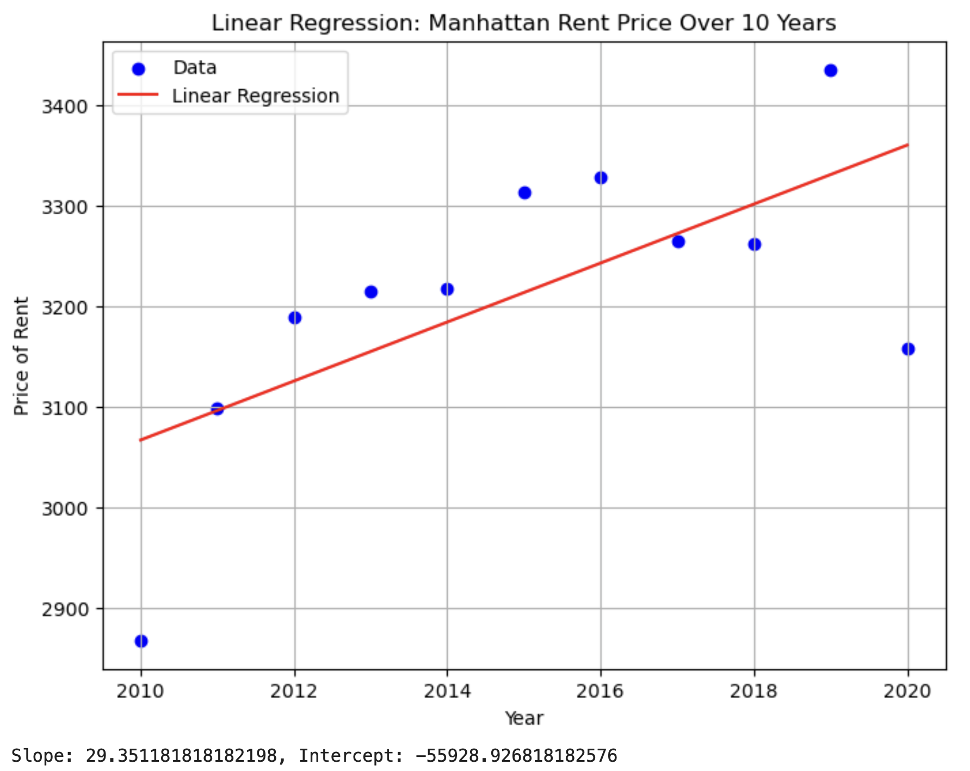
Manhattan

Slide 18
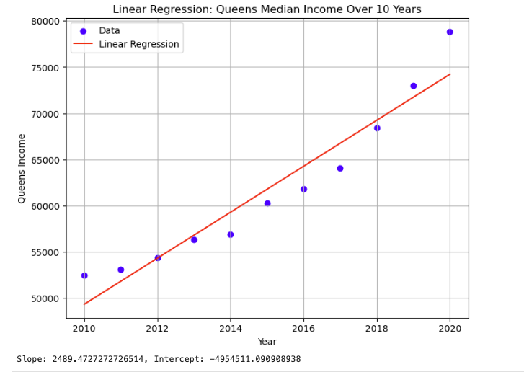
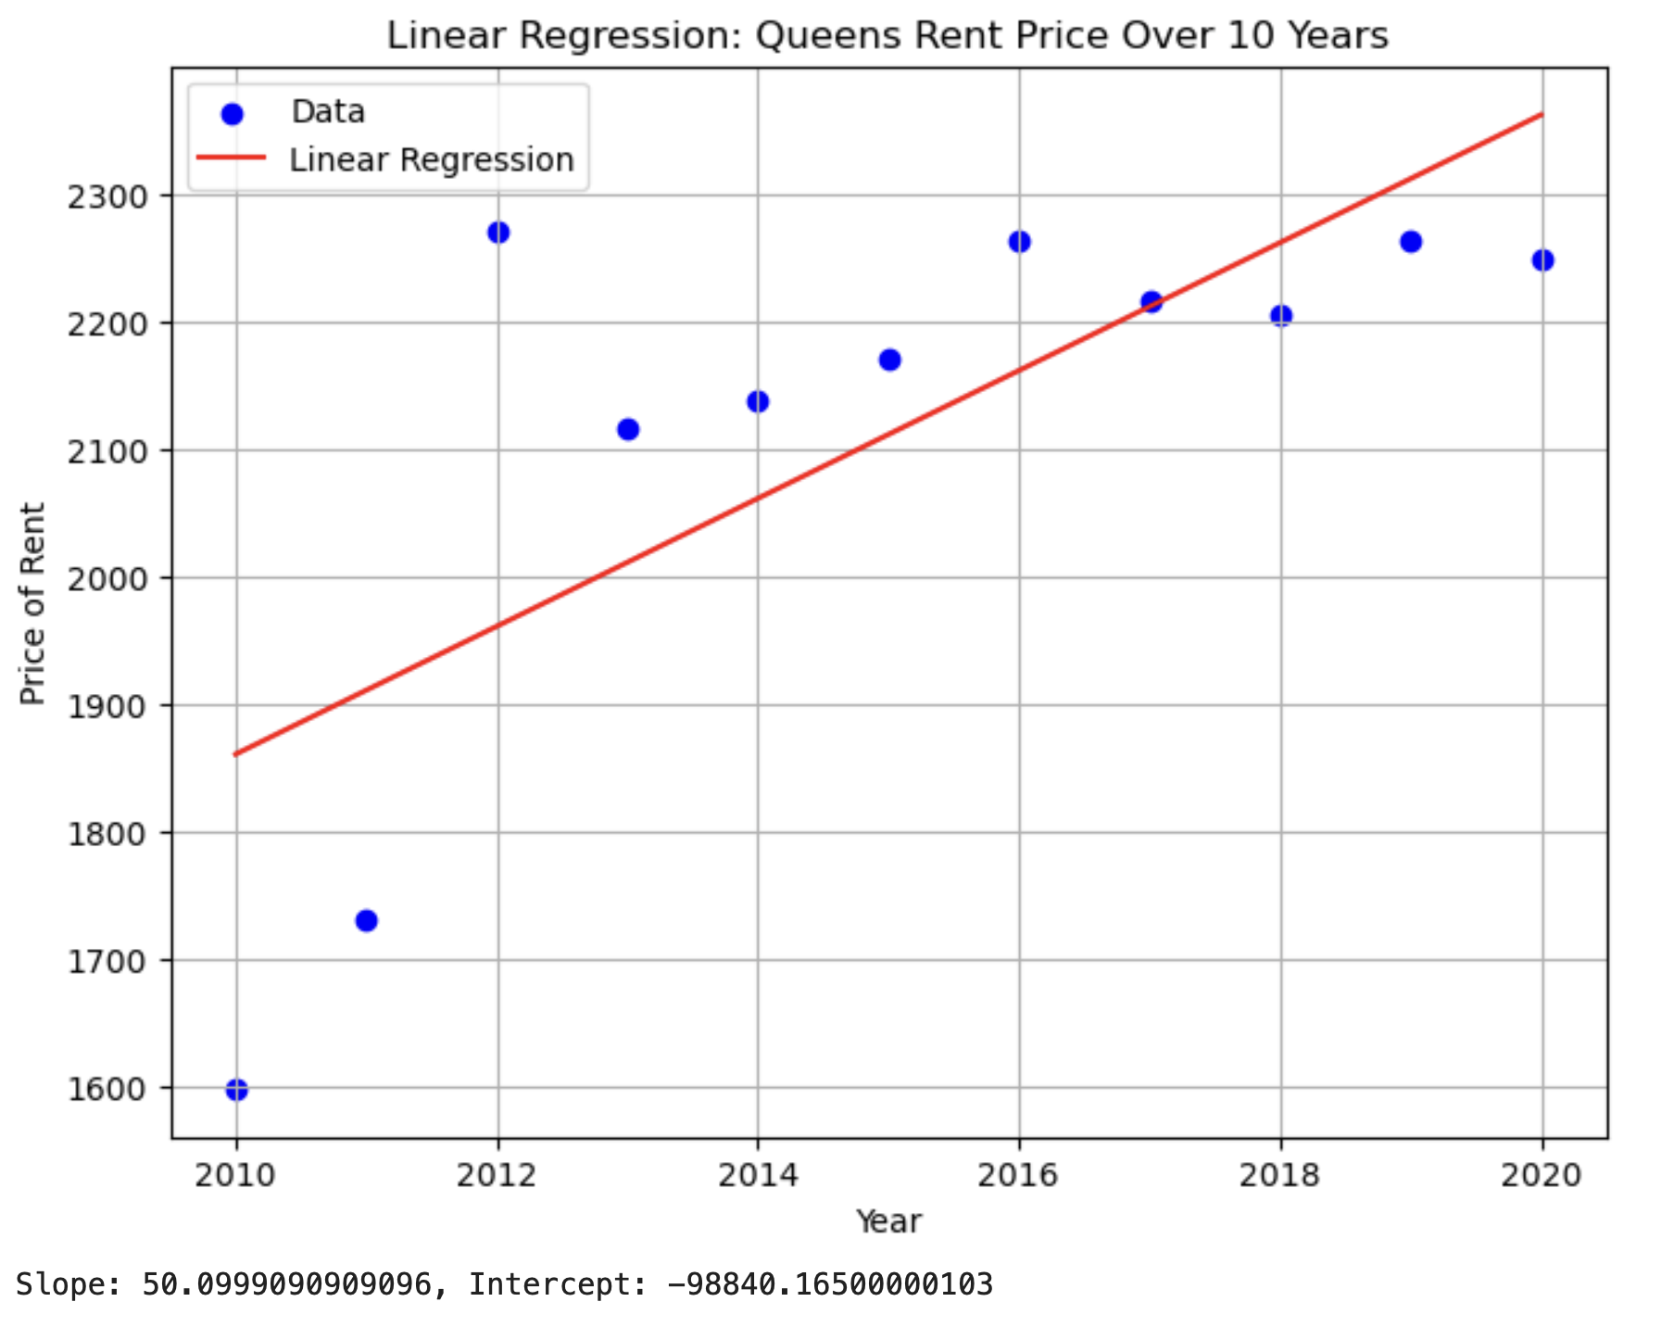
Queens

Slide 19
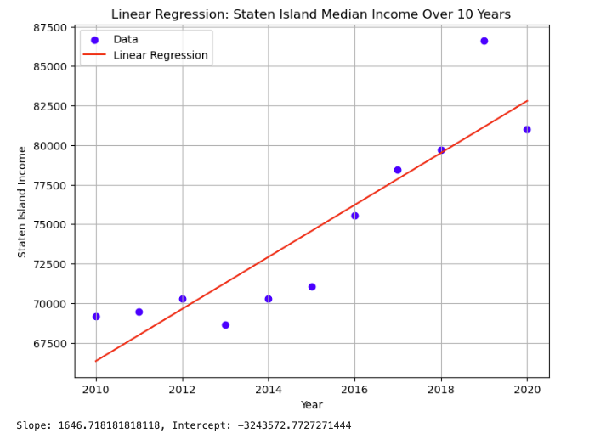
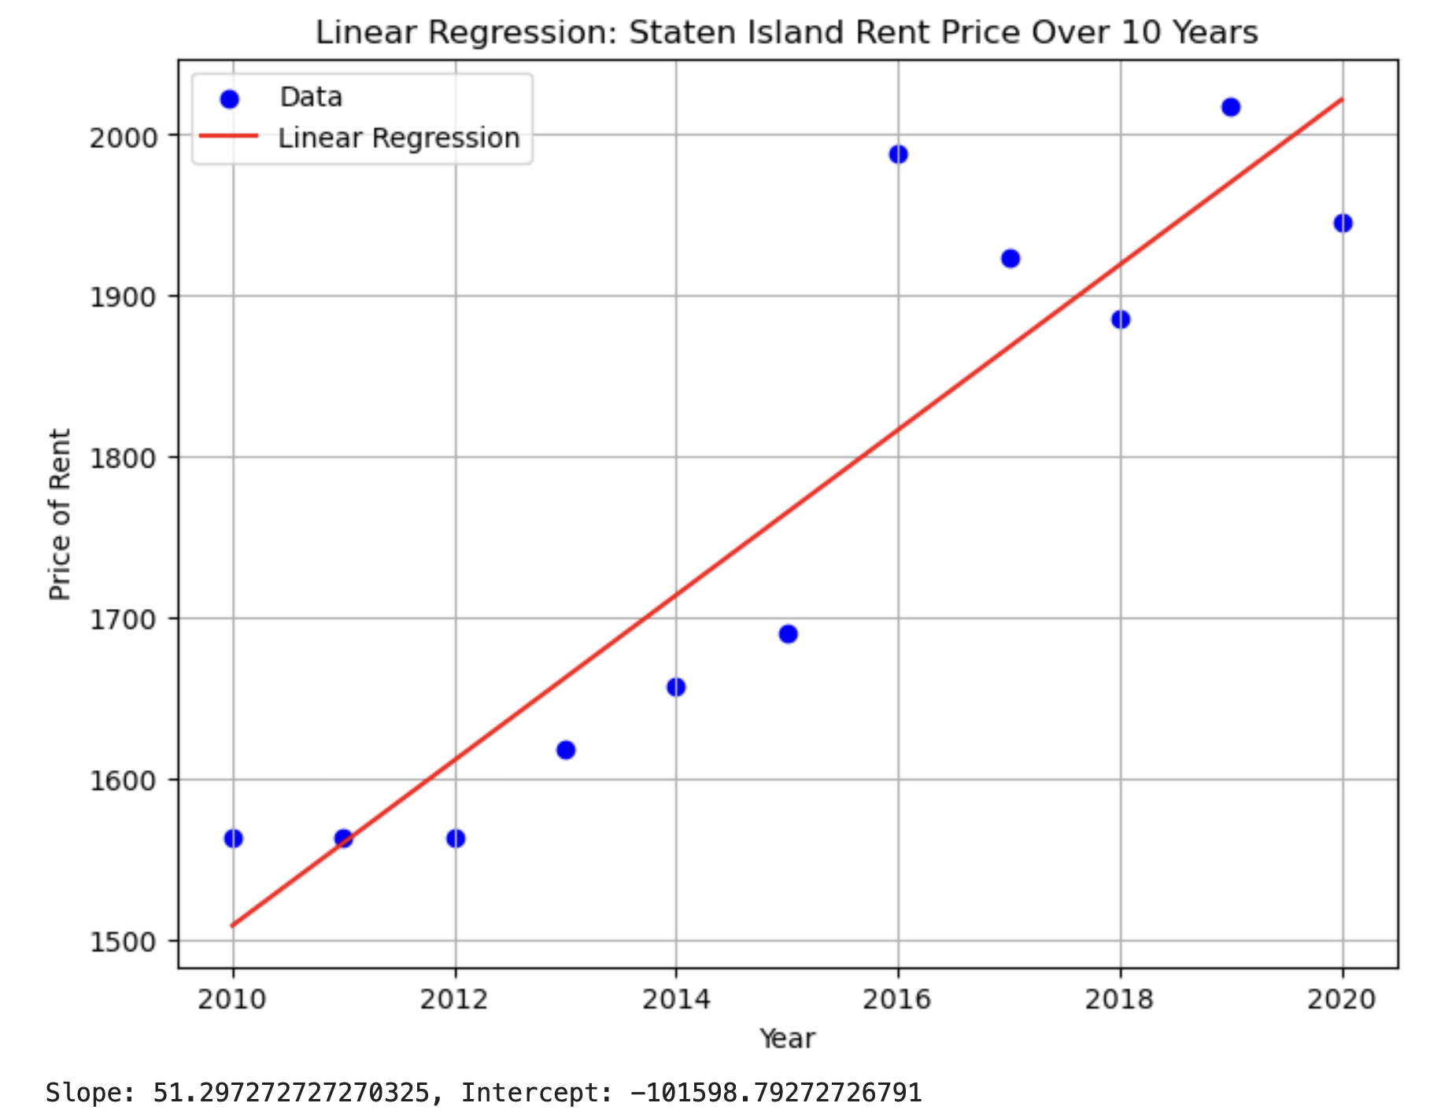
Staten Island

Slide 20
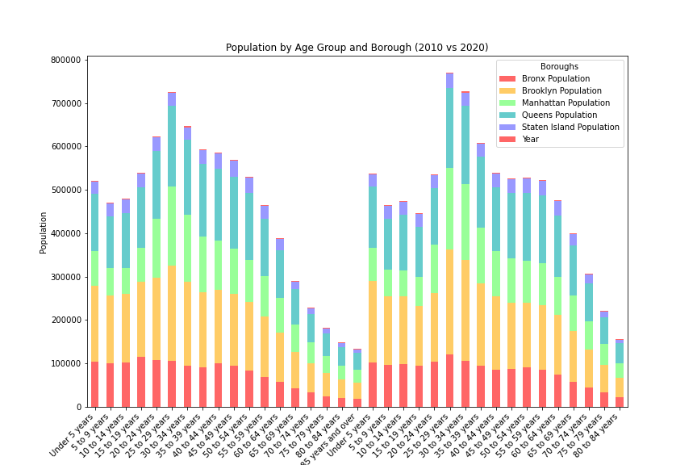
Population by Age Group: 2010 vs 2020
In the past decade, New York City has experienced significant demographic shifts with implications for urban development. Across most age groups and areas, there's been a trend of population growth, particularly notable in Brooklyn and Queens.

Slide 21
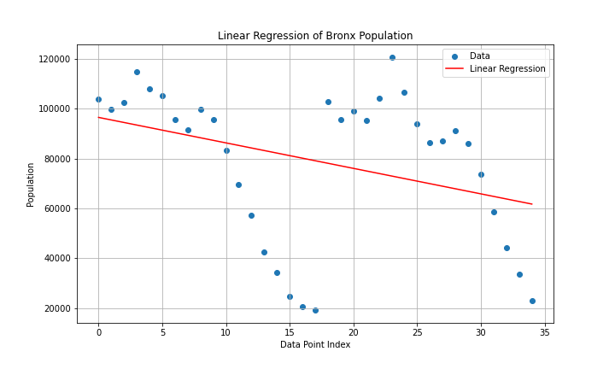
Bronx Linear Regression

Slide 22
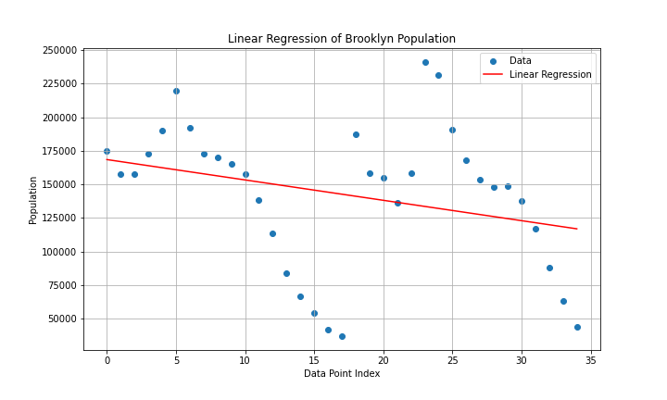
Brooklyn Linear Regression

Slide 23
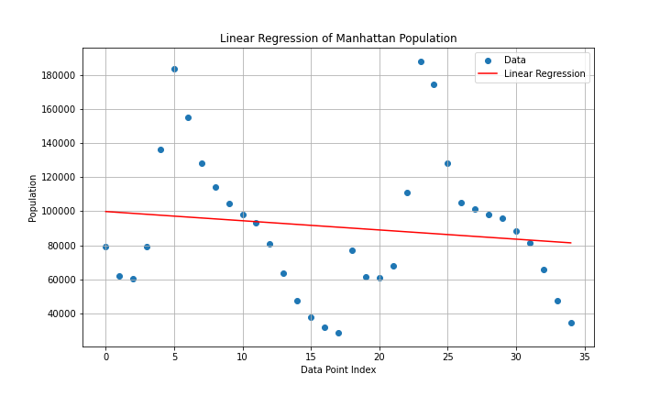
Manhattan Linear Regression

Slide 24
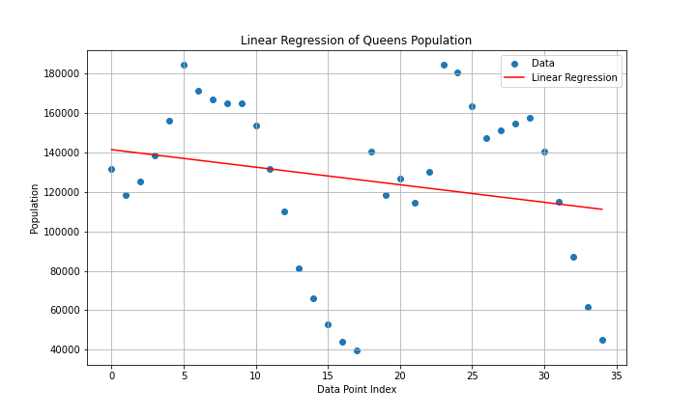
Queens Linear Progression

Slide 25
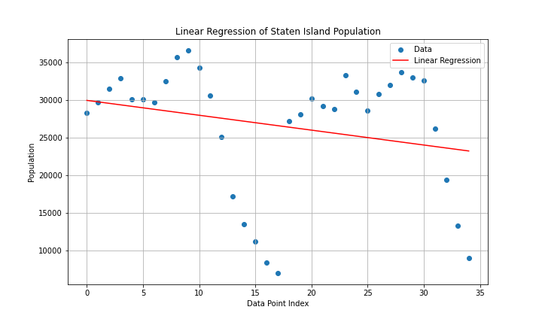
Staten Island Regression Line

Slide 26
Gender Questions:
How do gender demographics influence housing demand in urban areas?
What insights can we derive from analyzing demographic trends over time?
How do these trends impact policy making, especially regarding housing affordability?"

Slide 27
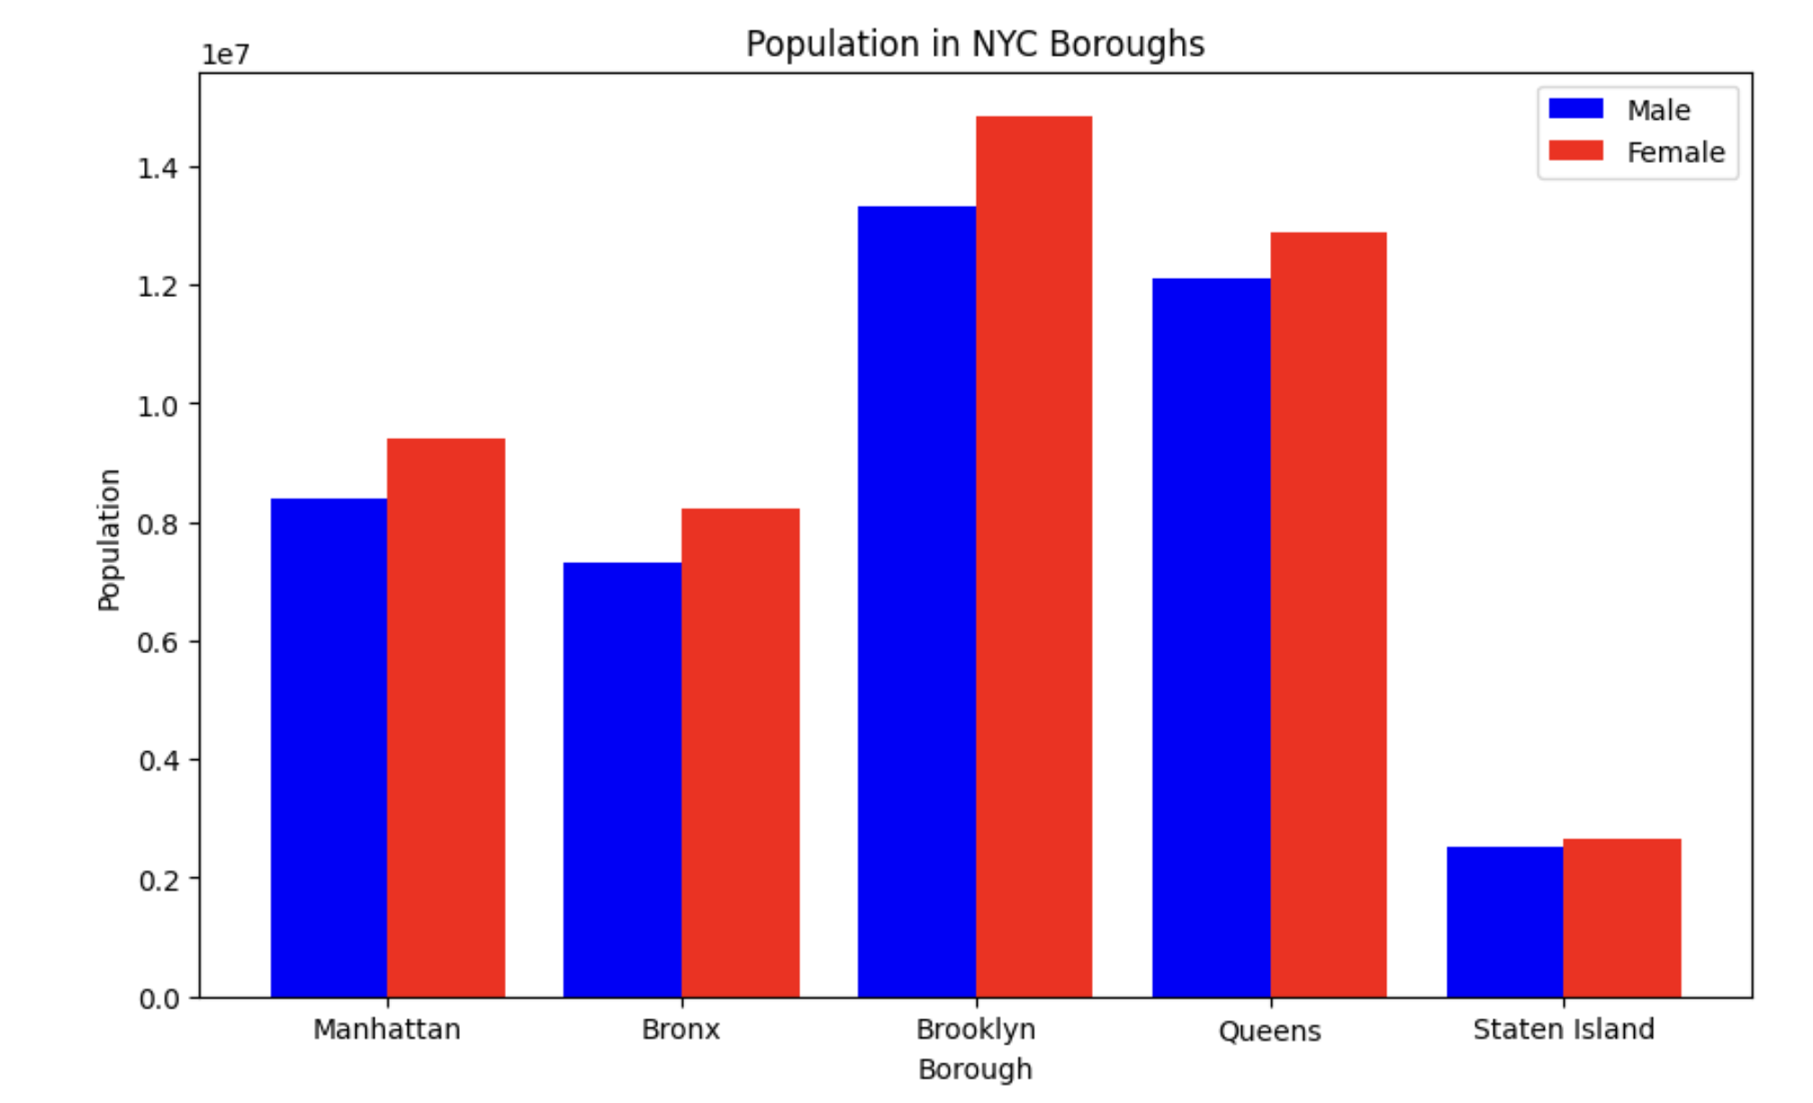
NYC Population by Gender
As we observe the gender demographics across NYC’s boroughs from our dataset interesting patterns emerge. Brooklyn and Queens lead in both male and female populations, reflecting their status as the most populous boroughs. Notably, in all boroughs, the female population surpasses the male, bringing unique challenges and opportunities for housing policy and urban planning.

Slide 28
Gender
The regression analysis and gender demographics reveal NYC’s unique urban dynamics compared to the national trends, significantly impacting housing affordability. Rapid population growth, particularly in boroughs like Brooklyn and Manhattan, underscores a pressing demand for housing. This demand, coupled with gender population disparities, necessitates strategic housing policies and spaces for all residents, highlighting the critical need for data-driven solutions in addressing urban housing challenges.

Slide 29
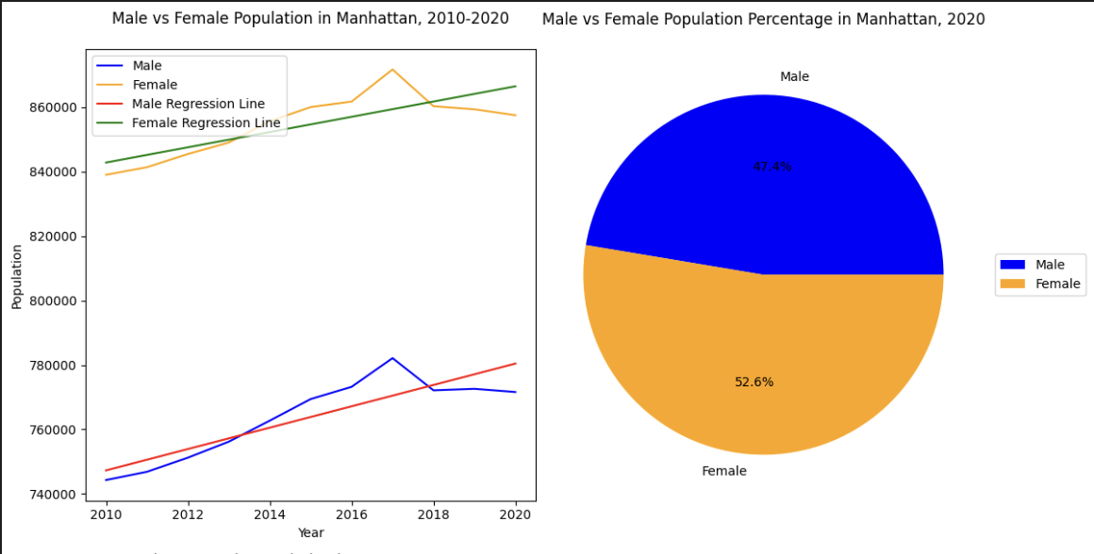
Regression Model Insights: Manhattan:

Slide 30
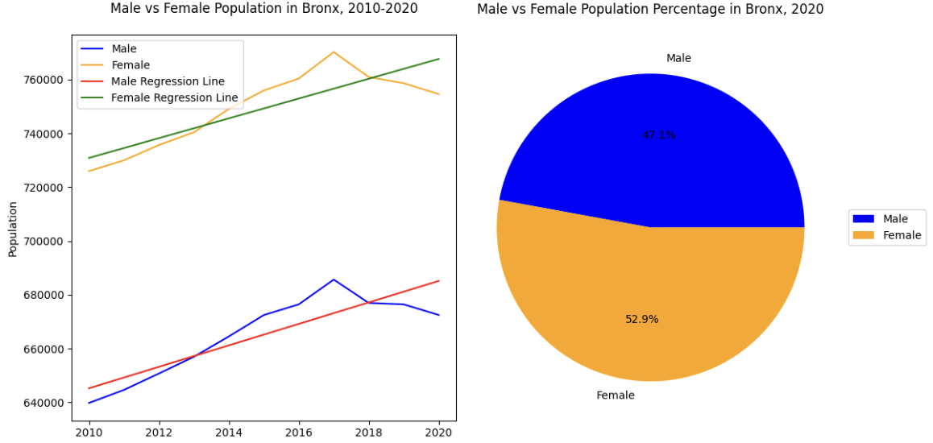
Bronx

Slide 31
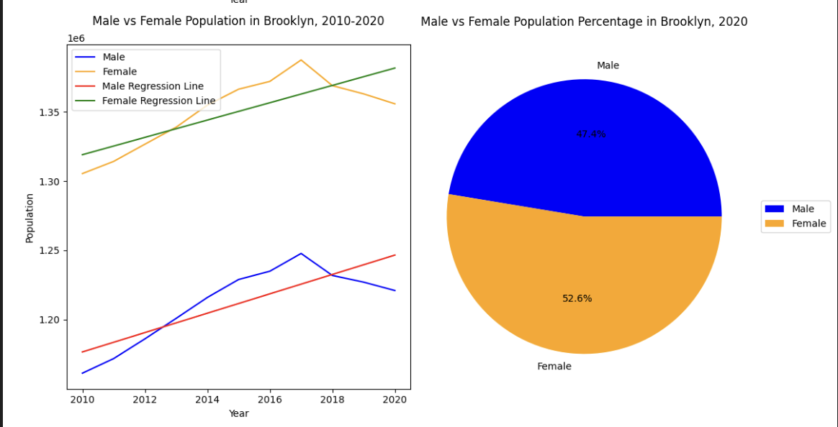
Brooklyn

Slide 32
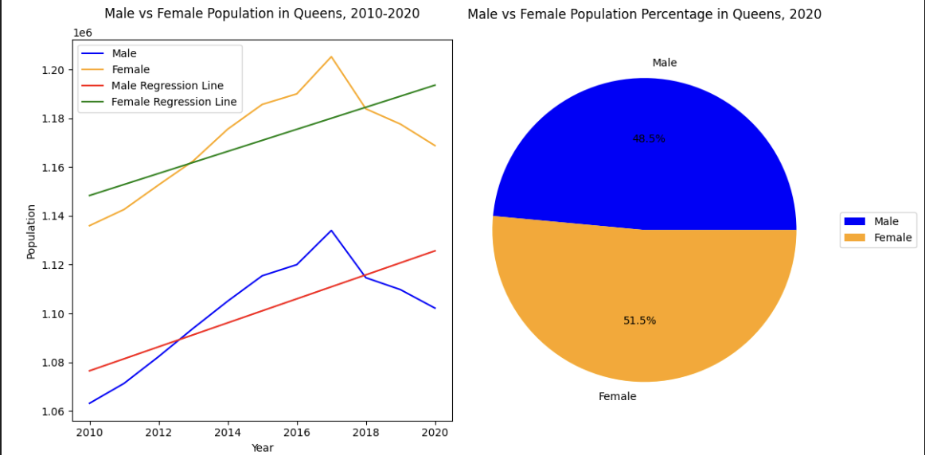
Queens

Slide 33
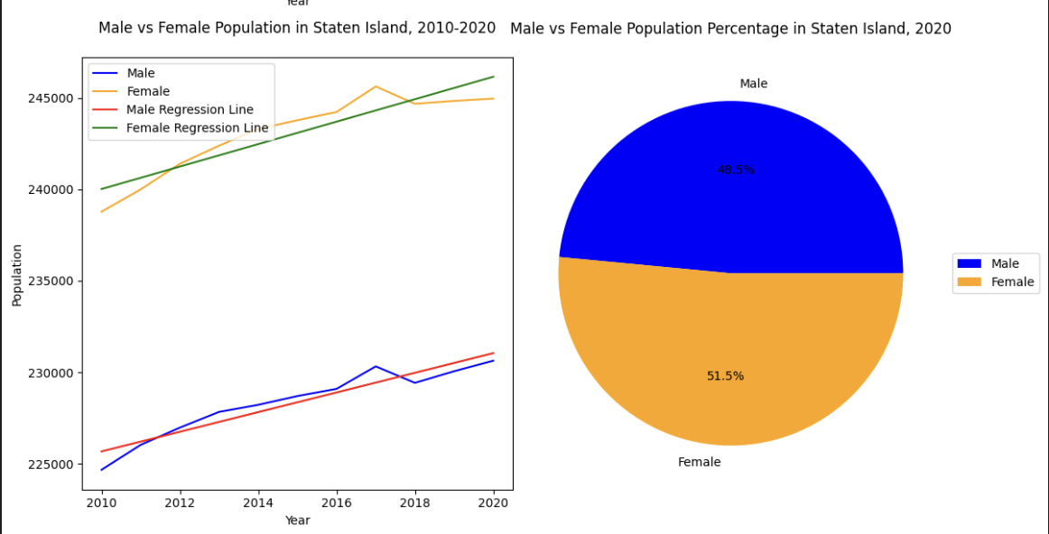
Staten Island

Slide 34
Gender Conclusions
In conclusion, with NYC's male population at around 4 million and female population at 4.4 million, compared to national figures significantly higher, the city’s unique urban dynamics present both challenges and opportunities for housing policy. Such demographic insights are not only critical for addressing current housing affordability issues but also for planning sustainable, inclusive urban futures.
Let's continue this conversation on how we can translate these insights into actionable strategies for New York City and similar urban landscapes.

Slide 35
Ethnicity
In the following bar graphs I aim to analyze the demographic trends of New York City based on its five boroughs and the six main ethnic groups that make up the city's population: White, Black, Hispanic, Asian, Native American and Indian American. The analysis aims to identify any significant changes that have occurred in these demographic groups over the past decade in relation to the years 2010 and 2020.
In the following pie graphs I aim to analyze the demographic trends of the United States based on the census data of 2010 and 2020 in this report. I will be focusing on the 5 main ethnic groups that make up the country's population. The purpose of this analysis is to identify any significant changes that have occurred in these demographic groups over the past decade.

Slide 36
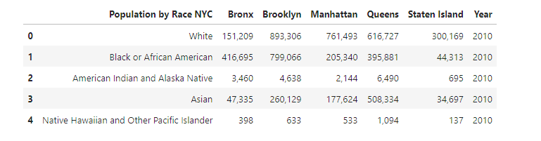
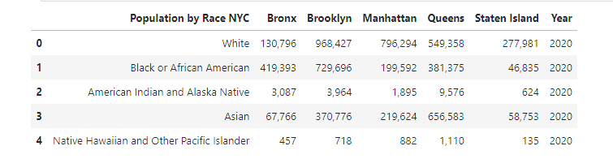
Population by Race and Borough in 2010 & 2020

Slide 37
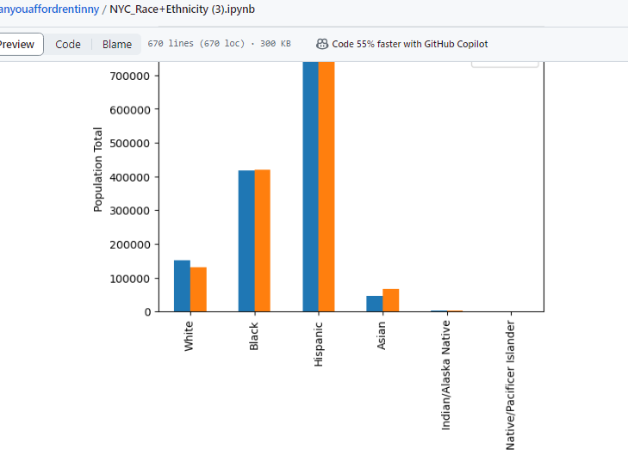
Bronx Population by Race: 2010 & 2020

Slide 38
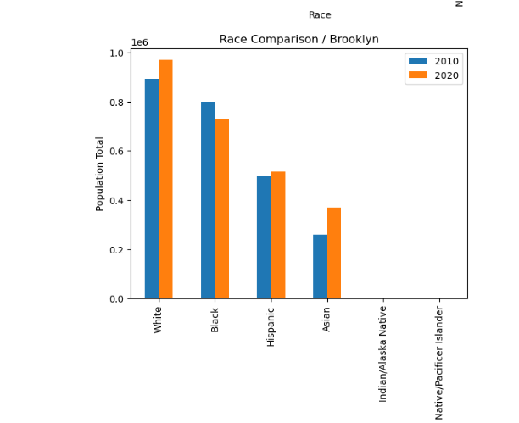
Brooklyn Population by Race: 2010 & 2020

Slide 39
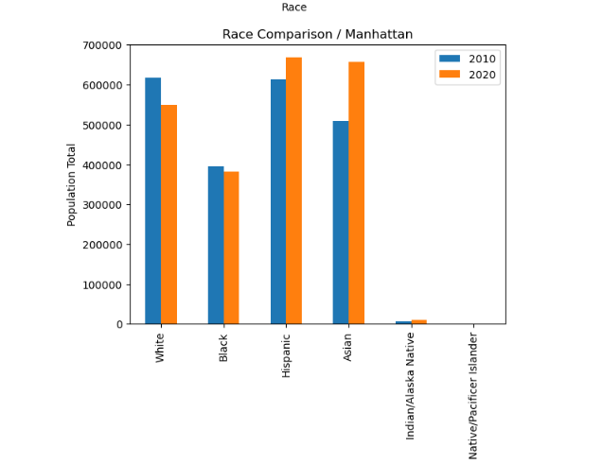
Manhattan Population by Race: 2010 & 2020

Slide 40
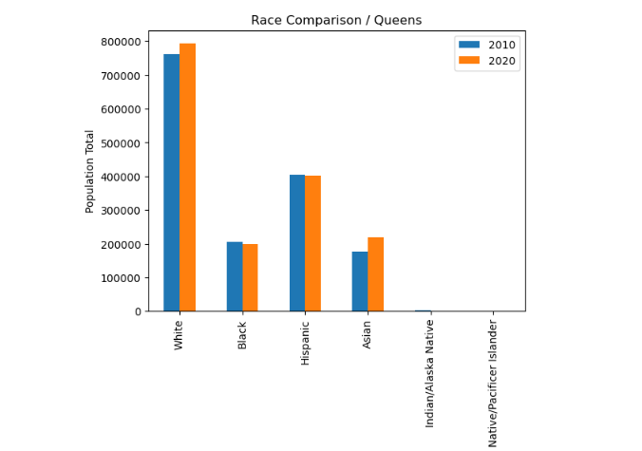
Queens Population by Race: 2010 & 2020

Slide 41
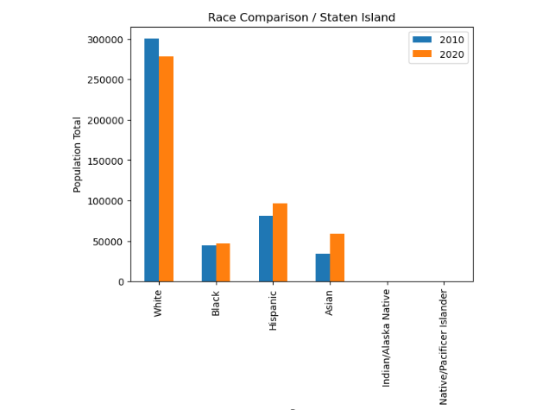
Staten Island Population by Race: 2010 & 2020

Slide 42
Ethnicity Questions (NYC):
1. How does the racial composition vary across the five boroughs of New York City? Each borough of New York City has its own unique racial composition. Manhattan tends to have a higher proportion of White and Asian residents, while the Bronx has a higher proportion of Black and Hispanic residents. Brooklyn also has a diverse population, including significant numbers of Black, White, Hispanic, and Asian residents. Queens is one of the most ethnically diverse urban areas in the world, with large populations of Hispanics, Asians, Whites, and Blacks. Staten Island has a higher proportion of White residents compared to the other boroughs.
2. Which are the fastest growing races in New York City? The Hispanic and Asian populations have been among the fastest-growing racial and ethnic groups in New York City. Both populations have seen significant increases in numbers and proportions within the city's overall demographic makeup.

Slide 43
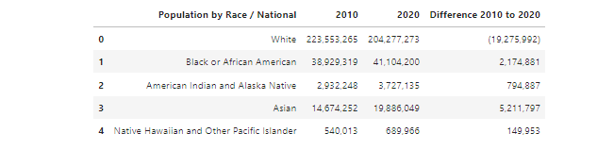
National Population by Race: 2010 & 2020

Slide 44
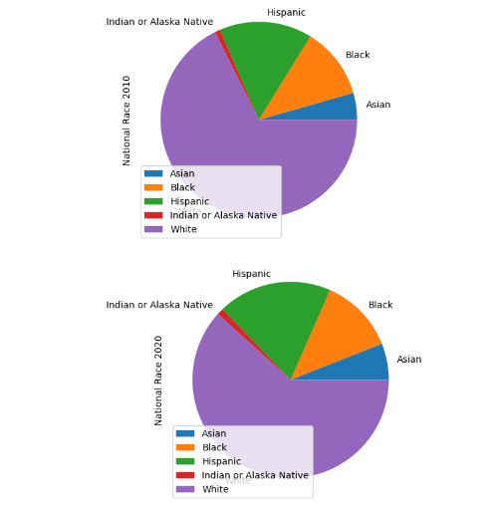
National Population by Race: 2010 & 2020

Slide 45
Ethnicity Questions (National):
1.Which is the race with significant decline in population? The White population remained the largest race or ethnicity group in the United States, with 204.3 million people identifying as White alone. However, the White alone population decreased by 8.6% since 2010 making it the fastest declining race.
2. How has the racial diversity of the United States changed over the past decade? The racial diversity of the United States has increased significantly over the past decade. The probability of selecting two individuals at random from different race or ethnicity groups has increased since 2010 as our nation becomes more racially and ethnically diverse

Slide 46
Summary Analysis
In the 2010-2020 NYC analysis, boroughs exhibited diverse trends: income levels generally rose and had a similar pattern of change year to year- with Manhattan exhibiting the more drastic outliers. Rental prices increased but at rates varying from borough income growth, stressing housing affordability. Age demographics highlighted growth in youth and older adults, demanding more services. Gender disparities persisted, with a higher female population impacting urban policies. Ethnicity and economic shifts suggested evolving cultural and economic landscapes, necessitating inclusive, responsive urban planning for a sustainable, vibrant NYC.

